Slide 1
Python is the most in-demand skill for a ML job.

Slide 2
FINDINGS
I was able to find 17 technologies/frameworks that I need to focus on to get a machine learning engineer job
 | Skills
Very Good | Python,sql,skicit,scala,pandas,git,numpy
Good | Pytorch,spark,Hadoop
Moderate to low | R,tensorflow,tableau,nlp,aws,mining,kubernetes

Slide 3
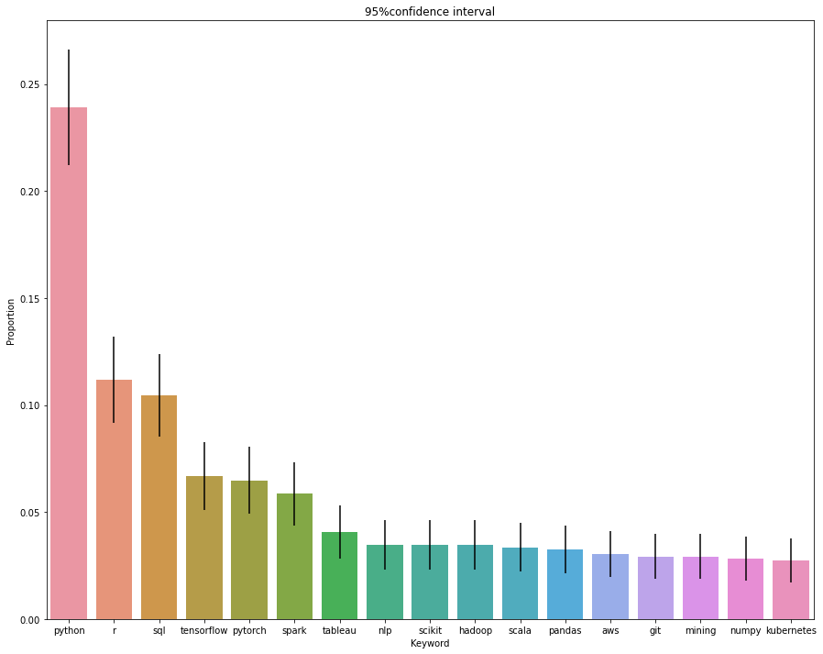

Slide 4


Slide 5

Now let’s see how I found out!

Slide 6
EXPERIMENT SETUP - 3 SIMPLE STEPS
SCRAPE DATA FROM LINKEDIN
EXTRACT KEYWORDS FROM SKILLS
ANALYSE THE FREQUENCY OF THE KEYWORDS

Slide 7
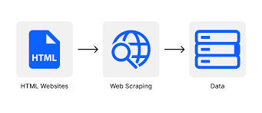
LINKEDIN JOB SCRAPING
1

Slide 8
STEPS
Import Selenium Webdriver to access the HTML elements of the webpage
I used the keyword –”Machine Learning Engineer” and “Data Scientist” to search for jobs in Linkedin
I got 175 job results for Machine Learning Engineer and 175 job results for Data Scientist
Information Scraped : Company, Job Title, Location, Posted Date, Link(url), Description, Skills

Slide 9
ISSUES FACED DURING THIS STEP
LINKEDIN STARTED TO BLOCK THE SCRAPING
After hitting the website multiple time,linkedin started to block my requests.So I had to come up with different elements to hit to get the same data.
COULDN’T SCRAPE SKILLS SECTION PROPERLY
I used the <li> - list item tag to get the skills information. But on some job links they had skills listed using <p> - paragraph tags. So I could’nt scrape skills for such jobs.

Slide 10
EXTRACT KEYWORDS
2

Slide 11
STEPS
We use Rake library which is part of the Natural Language Toolkit
Before we extract the keywords ,we add stopwords to Rake so that it does not include those words in the output
We manually add certain stopwords so that it doesn’t come up in the final analysis

Slide 12
KEYWORD FREQUENCY ANALYSIS
3

Slide 13
KEYWORD | FREQUENCY
python | 229
r | 107
sql | 100
tensorflow | 64
pytorch | 62
spark | 56
tableau | 39
nlp | 33
scikit | 33
hadoop | 33
scala | 32
pandas | 31
aws | 29
git | 28
mining | 28
numpy | 27
kubernetes | 26

Slide 14
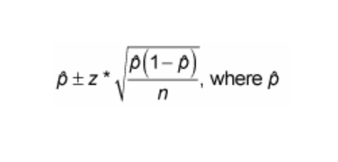
STEPS
We use the below formula to calculate the confidence intervals.
Where p is the proportion of the current keyword over the total number of keyword occurences
I generated graph for two different confidence intervals – 95% and 68% with z scores of 1.96 and 1 respectively

Slide 15
FOLLOW UP ACTIONS
WORK ON ATLEAST TWO INDUSTRY GRADE PROJECTS THAT FOCUSING ON MY WEAK AREAS(ESPECIALLY COMPUTER VISION PROJECT INVOLVING DEPLOYMENT USING KUBERNETES AND AWS
ONLINE COURSES/CERTIFICATIONS IN DEEP LEARNING
LEARN THROUGH PROJECTS

Slide 16
Thanks!
ANY QUESTIONS?
You can find me at
mdurais1@asu.edu

